Slide 1
Chapter 15
Organizatiàonal Techniques

Slide 2
Lateral thinking
Lateral search
Challenging assumptions
Fractionation
Brainstorming

Slide 3
Brainstorming - problems
Who does the systems analyst involve and from what business areas and should there be both management and shop-floor participation?
How many people should be invited – the larger it is then the more ideas that can be expressed, but too large a group becomes difficult to handle?
How can the subject matter be limited – we need a wide-ranging discussion to enable full expression of opinions, but this may lead to little being decided on the most pressing decisions?

Slide 4
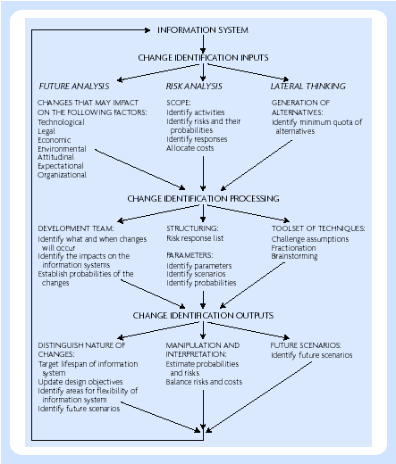
Requirements analysis

Slide 5
Critical Success Factors (CSFs)
Factors critical to all organizations in the same industry
Issues related to the particular organization and to its position in the industry
Environmental factors, such as legal, political, economic, and social aspects
Activities within the organization that are proving to be short-term problems
Monitoring and control procedures relating to the operations of the firm
Factors that take into account the changes in the business environment

Slide 6
Scenario planning
Morphological approaches
Cross-impact approaches

Slide 7
Other approaches
Future analysis
Strengths Weaknesses Opportunities and Threats Analysis (SWOT)
Case-based reasoning
Risk analysis

